Slide 1
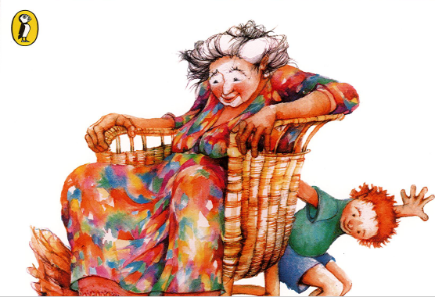
Wilfrid Gordon McDonald Partridge
Written by Mem Fox
Illustrated by Julie Vivas

Slide 2
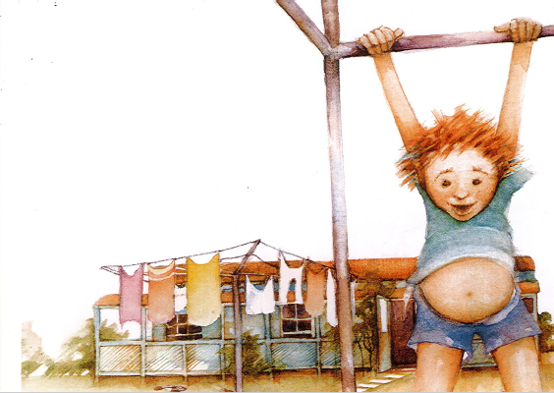

Slide 3
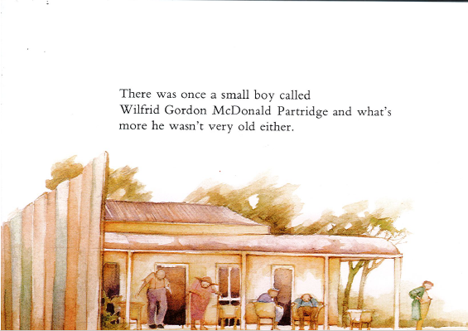
There once was a small boy called Wilfrid Gordon McDonald Partridge and what’s more he wasn’t very old either.
His house was next door to an old people’s home and he knew all the people who lived there.

Slide 4
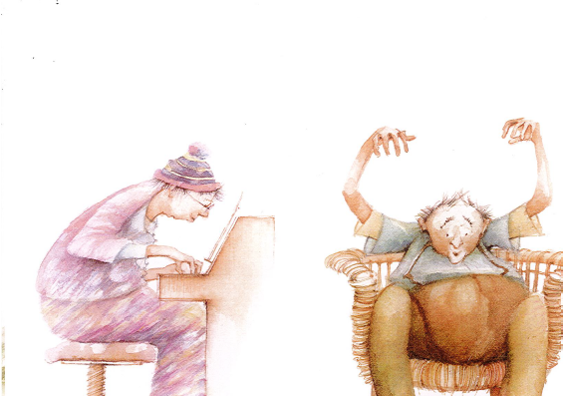
He like Mrs Jordan who played the organ. He listened to Mr Hosking who told him scary stories.

Slide 5
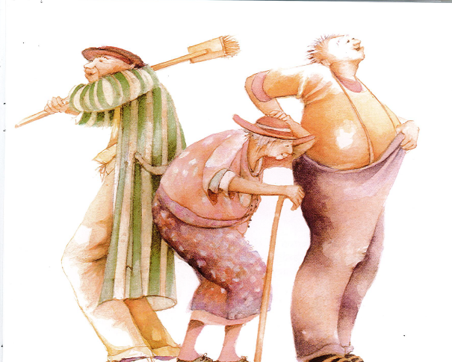
He played with Mr Tippet who was crazy about cricket. He ran errands for Miss Mitchell who walked with a wooden a stick. He admired Mr Drysdale who had a voice like a giant.

Slide 6
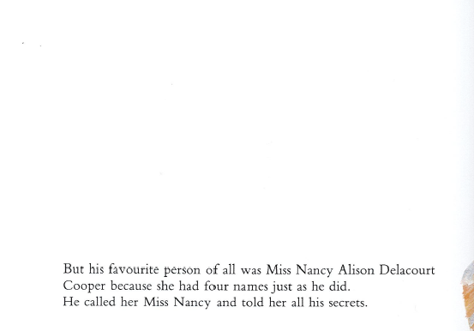

Slide 7
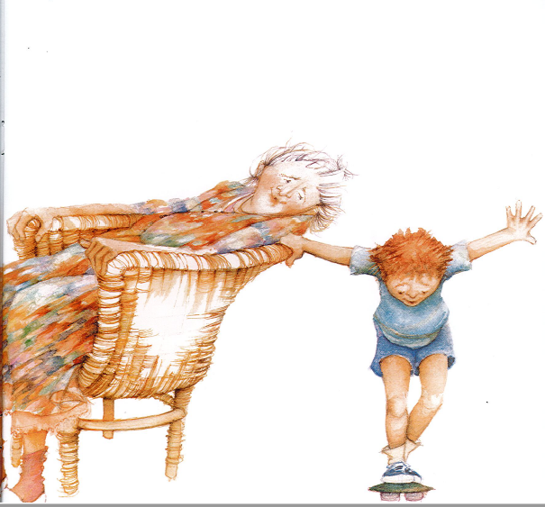

Slide 8
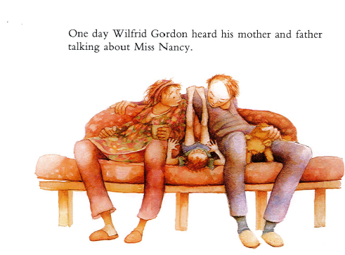
“Poor old thing,” said his mother.
“Why is she a poor old thing?” asked Wilfrid Gordon.
“Because she’s lost her memory,” said his father.
“It isn’t surprising,” said his mother. “After all, she is ninety-six.”
“What is a memory? Asked Wilfrid Gordon. He was always asking questions.
“It’s something you remember,” said his father.

Slide 9
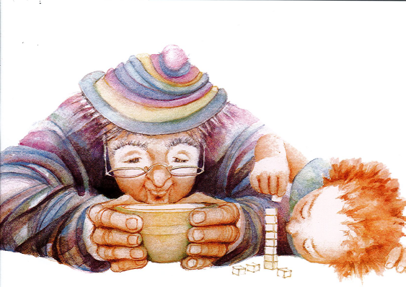
But Wilfrid Gordon wanted to know more, so he called on Mr Jordan who played the organ.
“What’s a memory?” he asked.
“Something warm, my child, something warm.”

Slide 10
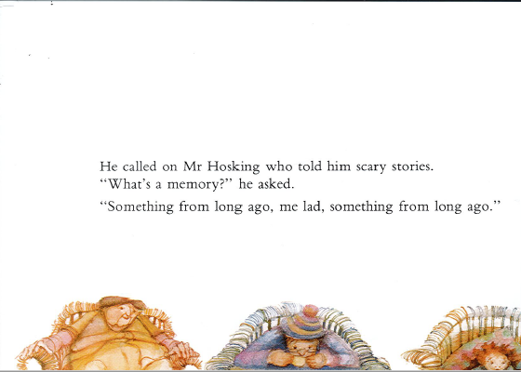

Slide 11
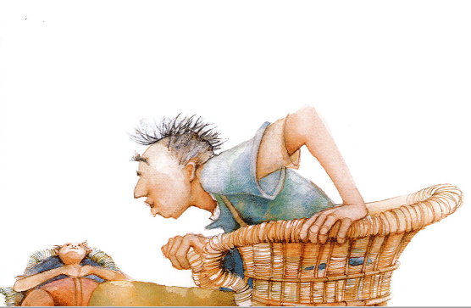

Slide 12
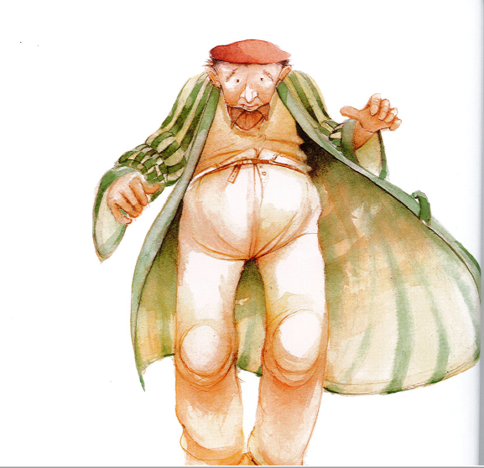

Slide 13
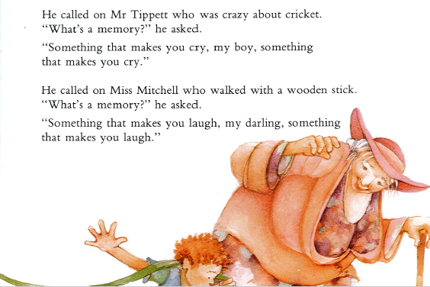

Slide 14
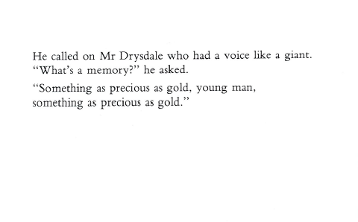

Slide 15
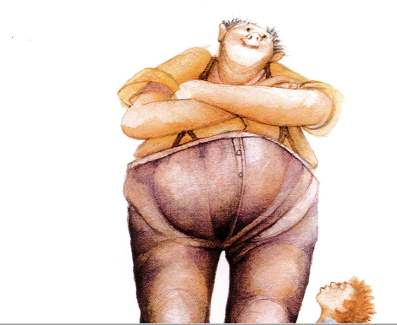

Slide 18
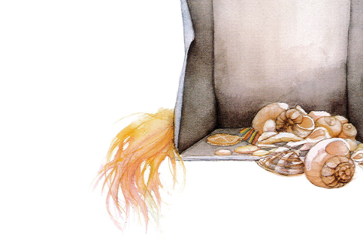
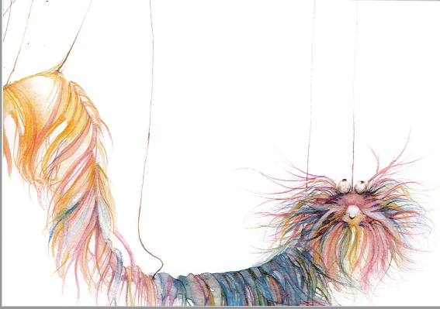
He looked for the shoe-box of shells he had found long ago last summer, and put them gently in a basket.
He found the puppet on strings which always made everyone laugh and he put that in the basket too.
He remembered with sadness the medal which his grandfather had given him and he placed it gently next to the shells.

Slide 19
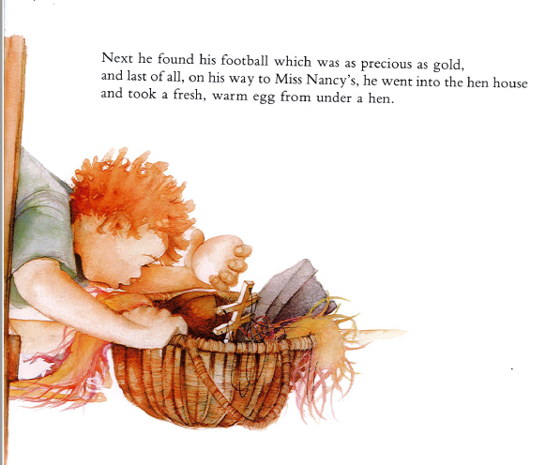
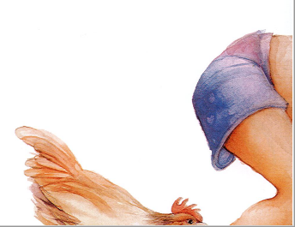

Slide 20
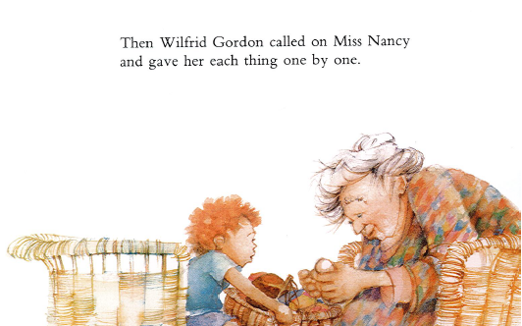

Slide 21
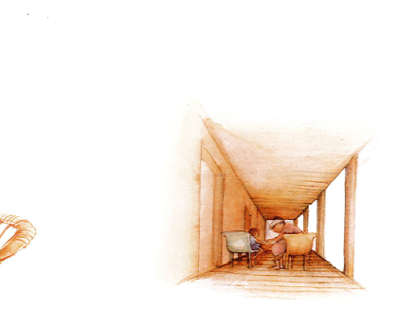
“What a dear, strange child to bring me all these wonderful things,” thought Miss Nancy.
Then she started to remember.

Slide 22
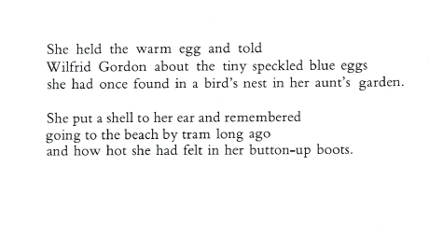

Slide 23
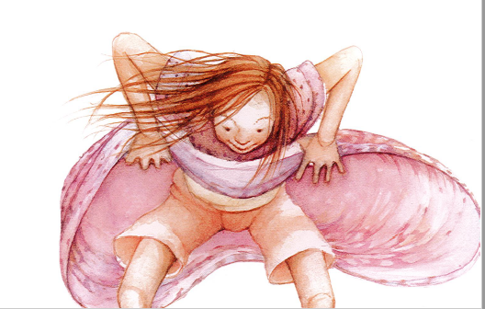

Slide 24
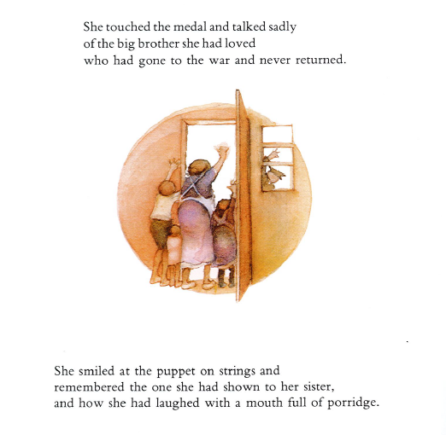

Slide 25
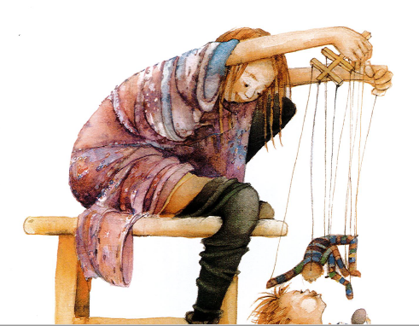

Slide 26
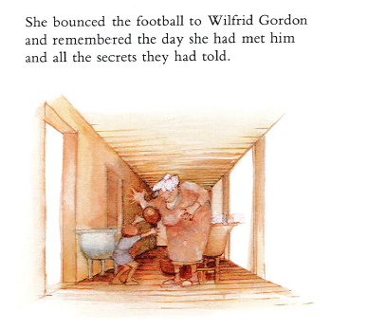
And the two of them smiled and smiled because Miss Nancy’s memory had been found again by a small boy, who wasn’t very old either.

Slide 27
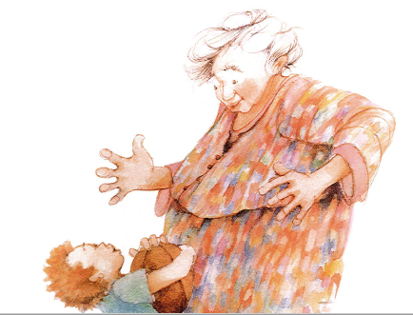

Slide 28
