Slide 2
Missing Number
Fill in the missing number:
9 × 2 =
18
Hide Answers
Show Answers

Slide 3
Missing Number
Fill in the missing number:
3 × 10 =
30
Hide Answers
Show Answers

Slide 4
Missing Number
Fill in the missing number:
7
× 5 = 35
Hide Answers
Show Answers

Slide 5
Missing Number
Fill in the missing number:
8 ÷ 2 =
4
Hide Answers
Show Answers

Slide 6
Missing Number
Fill in the missing number:
45 ÷ 5 =
9
Hide Answers
Show Answers

Slide 7
Missing Number
Fill in the missing number:
50
÷ 10 = 5
Hide Answers
Show Answers

Slide 8
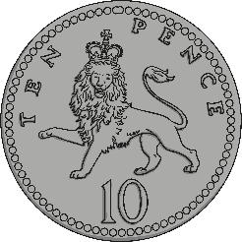
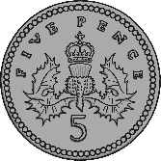
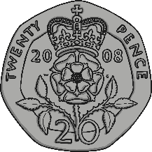
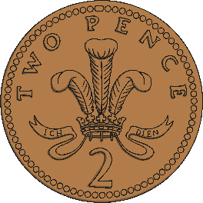
How Much?
How much money is there here?
49p
Hide Answers
Show Answers

Slide 9
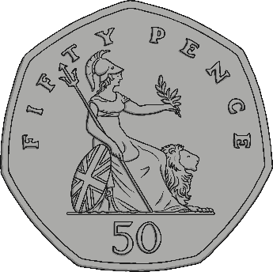
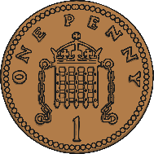
How Much?
How much money is there here?
73p
Hide Answers
Show Answers

Slide 10
How Much?
How much money is there here?
88p
Hide Answers
Show Answers

Slide 11
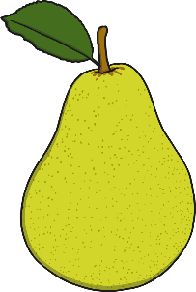
Shopping
Sam buys two pieces of fruit. He spends exactly 50p. Which fruit does he buy?
20p
10p
30p
40p
either banana and pear or apple and grapes
Hide Answers
Show Answers

Slide 12
Shopping
Sam buys three pieces of fruit. He spends exactly £1. Which fruit does he buy?
20p
30p
20p
40p
either 2 apples and grapes or 2 grapes and a banana or 2 grapes and a pear
Hide Answers
Show Answers

Slide 13
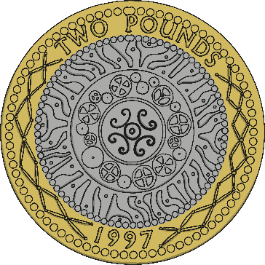
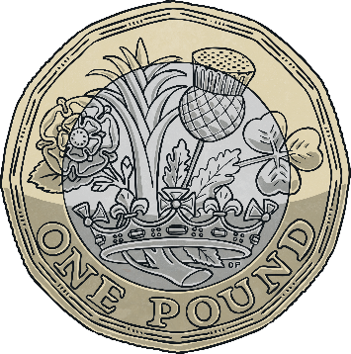
Take Less than 50p
Mum tells Dan he can take any coin from her purse that is less than 50p. Which coins can he take?
20p, 10p, 5p, 2p, 1p
Hide Answers
Show Answers

Slide 14
Number Line
Write the number that would go in each box:
25
39
20
30
40
Hide Answers
Show Answers

Slide 15
Number Line
Write the number that would go in each box:
53
66
50
60
70
Hide Answers
Show Answers

Slide 16
Packs of Pencils
Mrs Jones wants 30 pencils for her class. There are 10 pencils in one pack. How many packs of pencils does she need?
3 packs
Hide Answers
Show Answers

Slide 17
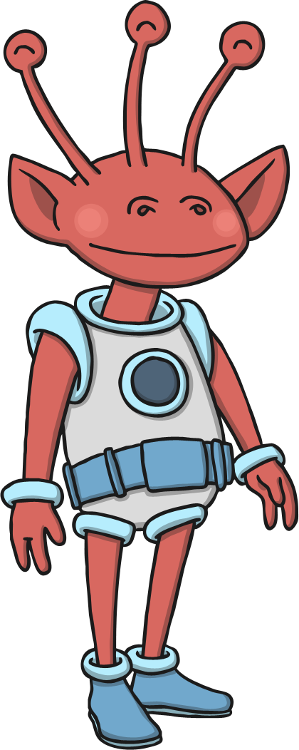
The Planet Zarg
Aliens from the Planet Zarg have three eyes each. How many eyes do 5 aliens have altogether?
15 eyes
Hide Answers
Show Answers

Slide 18
The Book Shop
One book costs £5.
Sunil wants to buy 3 books.
He works out how much this will cost. Which two calculations could he use?
5 + 3
5 + 5 + 5
3 x 5
3 + 3 + 3
5 + 5 + 5
3 x 5
Hide Answers
Show Answers

Slide 19
Fractions of Shapes
Which shape has ¾ shaded?
Hide Answers
Show Answers

Slide 20
Fractions
Calculate:
½ of 10
5
Hide Answers
Show Answers

Slide 21
Fractions
Calculate:
¼ of 12
3
Hide Answers
Show Answers

Slide 22
Fractions
Calculate:
two quarters of eight
4
Hide Answers
Show Answers

Slide 23
Fractions
Calculate:
¾ of 16
12
Hide Answers
Show Answers

Slide 24
What Number
I’m thinking of a number.
Half of my number is 8.
What is my number?
16
Hide Answers
Show Answers

Slide 25
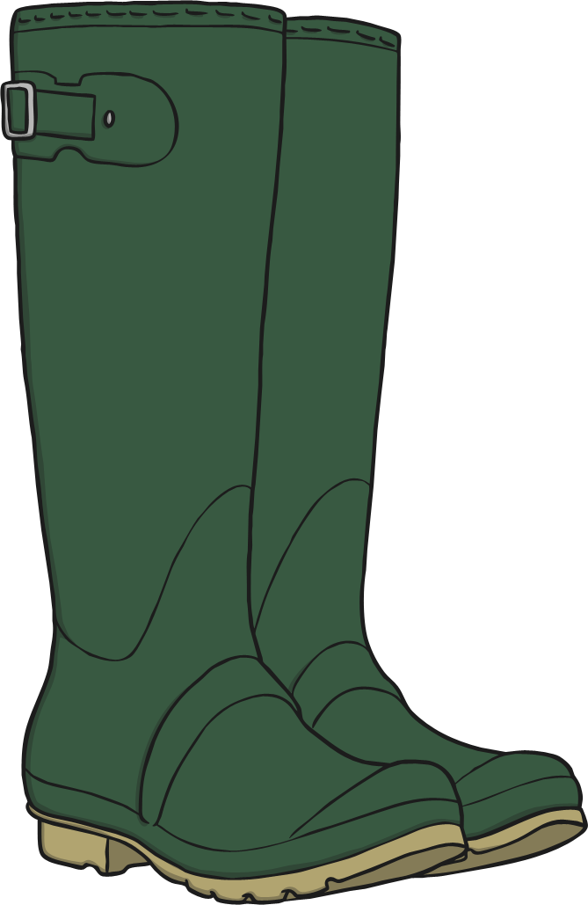
Word Problems
There are 18 wellies in the school cloakroom. How many children have brought wellies to school?
18 ÷ 2 = 9 children
Hide Answers
Show Answers

Slide 26
Word Problems
Matthew is sharing his grapes with Tom. He gives Tom half of his grapes. Tom has 10 grapes. How many grapes did Matthew have to begin with?
10 × 2 = 20 grapes
Hide Answers
Show Answers

Slide 27
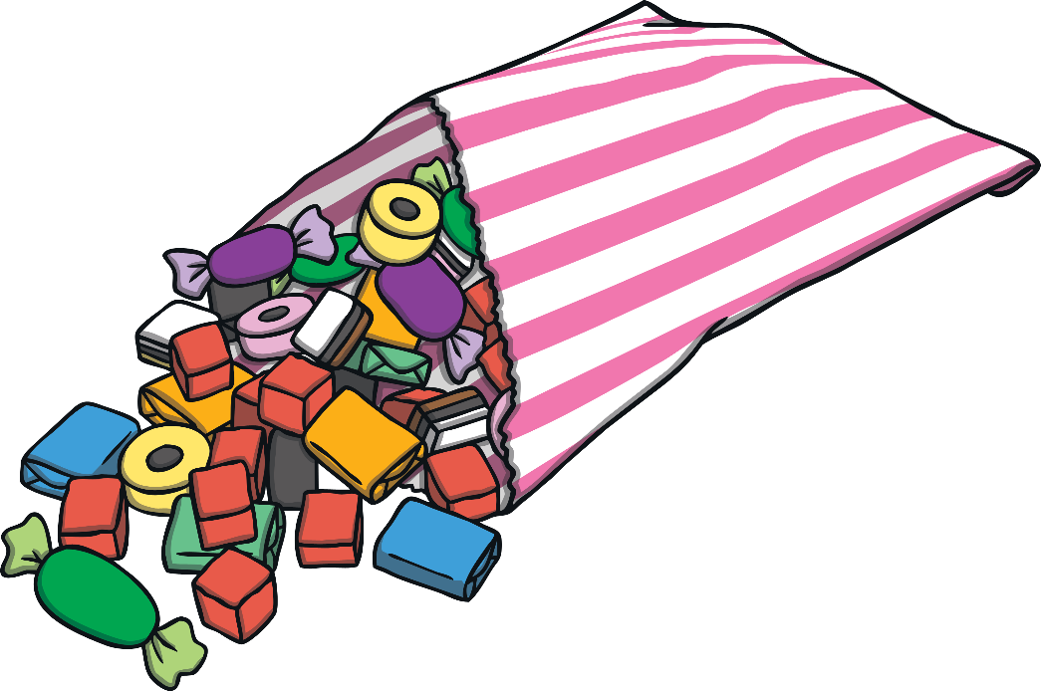
Word Problems
Maddie has 16 sweets. She gives one quarter of them to her little sister. How many sweets does Maddie have left?
16 ÷ 4 = 4 sweets
16 - 4 = 12 sweets
Hide Answers
Show Answers

