Slide 2
Missing Number
Fill in the missing number:
9 + = 16
7
Hide Answers
Show Answers

Slide 3
Missing Number
Fill in the missing number:
18 - = 9
9
Hide Answers
Show Answers

Slide 4
Missing Number
Fill in the missing number:
+ 5 = 11
6
Hide Answers
Show Answers

Slide 5
Missing Number
Fill in the missing number:
- 7 = 10
17
Hide Answers
Show Answers

Slide 6
True or False
Which two sentences are correct?
A rectangle has four sides of equal length.
A rectangle has lines of symmetry.
A rectangle has four corners.
A rectangle has curved sides.
A
B
C
D
Hide Answers
Show Answers

Slide 7
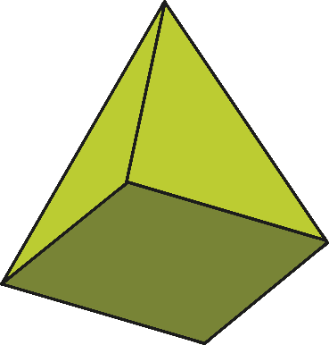
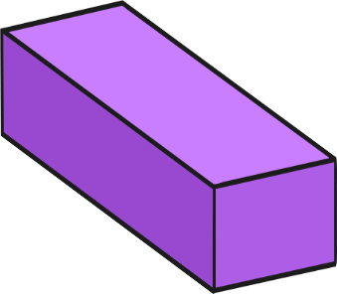
Which Shape?
Which shape has six faces?
Hide Answers
Show Answers

Slide 8
Matching
Match each shape to its name:
octagon
square
triangle
pentagon
Hide Answers
Show Answers

Slide 9
Rotation
This arrow has been rotated anticlockwise. How far has the arrow been rotated?
quarter turn
half turn
three-quarter turn
full turn
A
B
C
D
Hide Answers
Show Answers

Slide 10
Word Problems
There are 20 butterflies on a bush. 8 butterflies fly away. How many are left?
20 – 8 = 12 butterflies
Hide Answers
Show Answers

Slide 11
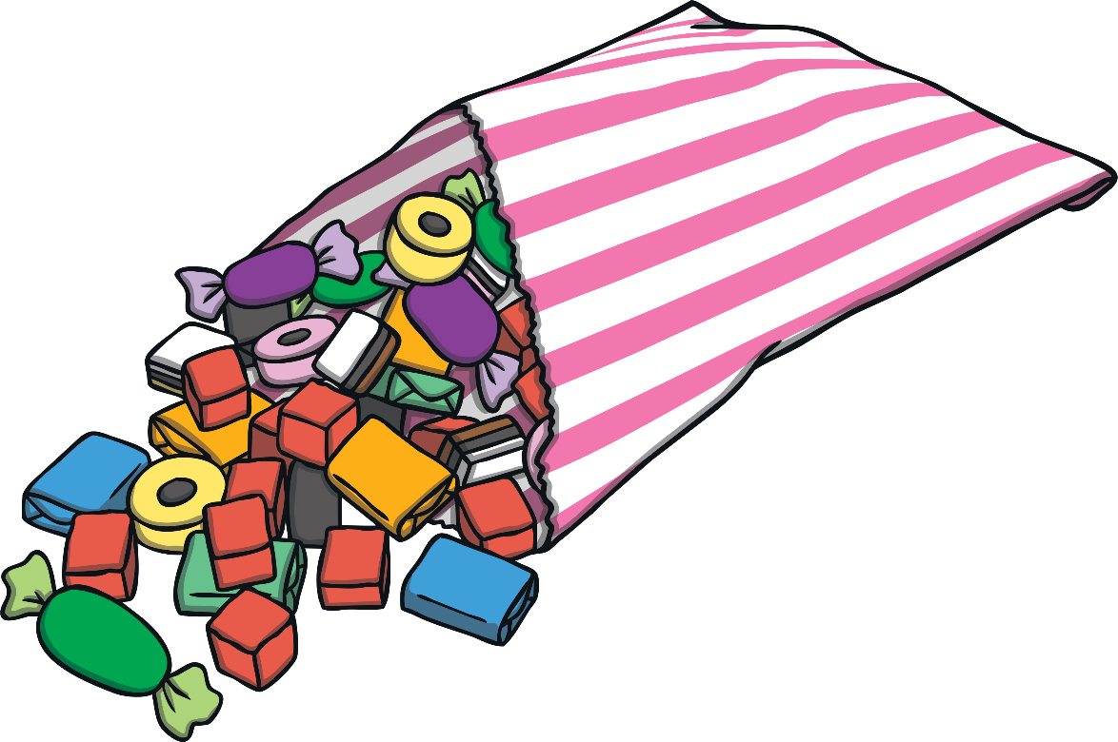
Word Problems
James has a bag of sweets. He gives 9 sweets to Ali. He has 14 sweets left. How many sweets did he have to start with?
14 + 9 = 23 sweets
Hide Answers
Show Answers

Slide 12
Word Problems
There are 25 grapes on a bunch. Dan takes 7 grapes. Mo takes 9 grapes. How many grapes are left on the bunch?
25 – 7 - 9 = 9 grapes
or 7 + 9 = 16
25 – 16 = 9 grapes
Hide Answers
Show Answers

Slide 13
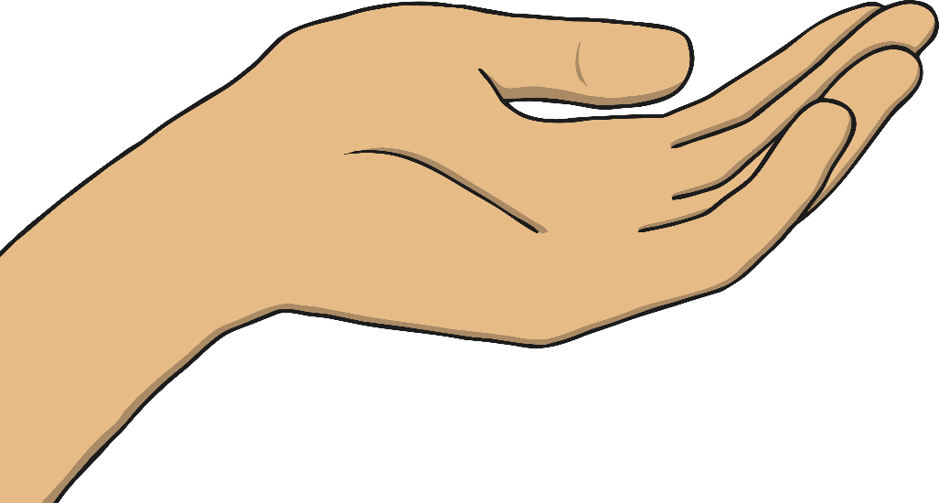
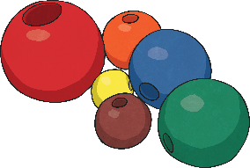
Word Problems
Ellie has 19 beads altogether. She has 6 in one hand. How many does she have in the other hand?
19 – 6 = 13 beads
Hide Answers
Show Answers

Slide 14
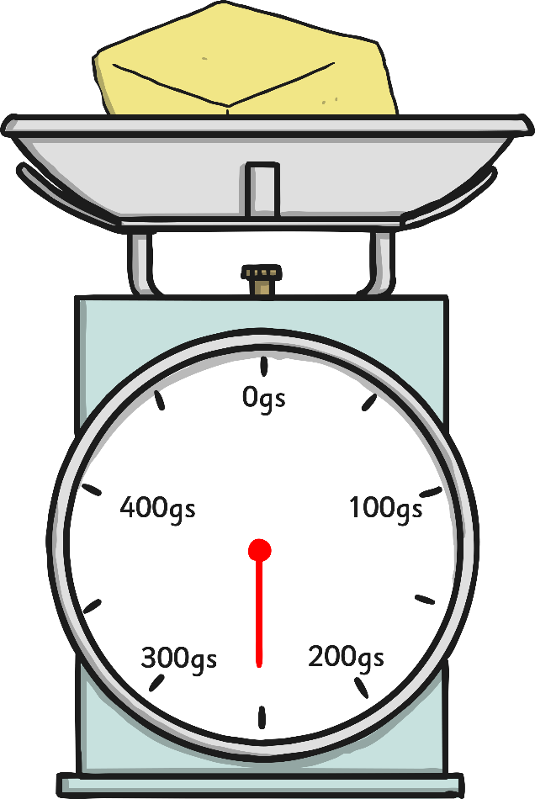
How Much?
How much does the butter weigh?
250g
Hide Answers
Show Answers

Slide 15
More than, Less than
Here is the weight of some different fruit.
50g
65g
100g
120g
Use these symbols to fill in the boxes: < > =
>
>
=
orange banana
pear apple
2 apples banana
Hide Answers
Show Answers

Slide 16
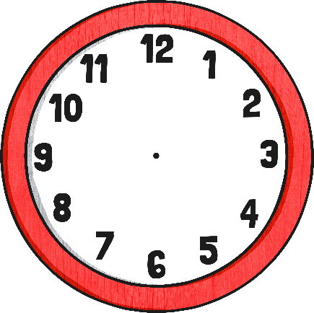
Time to Tell the Time
Which clock shows twenty past three?
A
B
C
D
Hide Answers
Show Answers

Slide 17
Word Problems
Lily starts school at 9 o’clock. She arrives 15 minutes early. What time does she arrive at school?
She arrives at 8.45 or quarter to 9.
Hide Answers
Show Answers

Slide 18
How Many?
How many seconds in a minute?
How many minutes in one hour?
How many hours in one day?
How many seconds in two minutes?
How many hours in two days?
A
60 seconds
B
60 minutes
C
24 hours
D
120 seconds
E
48 hours
Hide Answers
Show Answers

Slide 19
Worth What?
What is the blue number worth?
43
27
99
137
40
7
90
30
Hide Answers
Show Answers

Slide 20
Represent
What is this number?
1
10
10
10
1
1
10
1
1
1
10
10
10
1
1
78
Hide Answers
Show Answers

