Slide 2
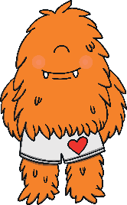
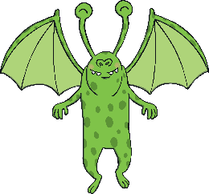
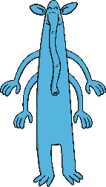
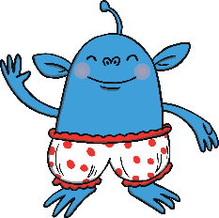
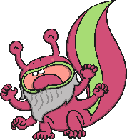
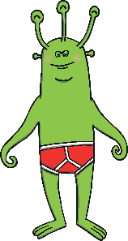
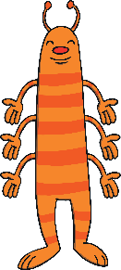
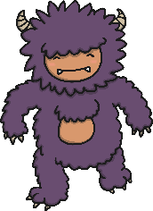
The Adverb Party Mix-Up
Day 1
Grammar Focus – G1.6: Adverbs
Some sneaky words have dressed up in disguise and have crept into this adverb family party. Can you make a list of the words which are not adverbs?
smiley
curly
ugly
sly
oily
carefully
quickly
silly
slowly
sadly
Molly
bully
monthly
creepily
Challenge: Can you write a rule to help people to figure out which words are not adverbs?

Slide 3
The Adverb Party Mix-Up - Answers
Day 1
Grammar Focus – G1.6: Adverbs
The intruders have been asked to leave the party. Hooray!
smiley
curly
ugly
sly
oily
carefully
quickly
silly
slowly
sadly
Molly
bully
monthly
creepily
What was your rule for deciding which words were adverbs? If the word describes how the verb (action) is being done then it is an adverb. e.g. ‘I was quickly chased by the aliens’.

Slide 4
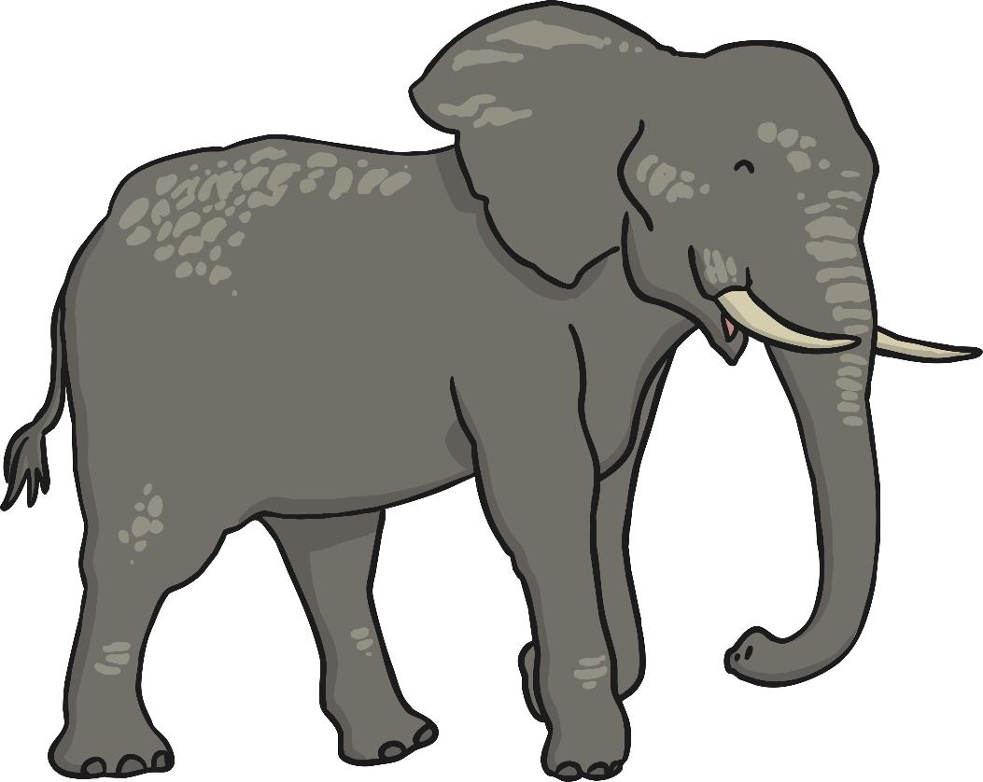
How to Wash Your Elephant
Day 2
Reading Focus – 1c: Identify and explain the sequence of events.
Have you got an elephant who is always rolling in mud?
Elephants need to be kept clean or they can often become unhealthy. Use this handy set of instructions to ensure you keep your pet squeaky clean.
Read this set of instructions and answer the questions on the next slide.
Equipment
an extra long hosepipe (at least 10 metres)
a set of step ladders
a large sweeping brush with stiff bristles
a bottle of elephant shampoo
a pair of elephant nail clippers
a sheet of sand paper
a feather duster
Method
Firstly, prepare your elephant for their bathing session in an area with plenty of space. Make sure that your animal is calm, well-fed and content. It may help to tickle their tummies to relax them if they are nervous about getting wet.
Next, prop up the step ladders beside your pet otherwise it is impossible to reach the top of their body. Climb the ladders carefully as you carry the hosepipe. Use lukewarm water to completely soak your elephant’s skin.
After that, squeeze a whole bottle of elephant shampoo onto the animal’s back. Use the sweeping brush to reach up and scrub every part of their dirty skin. Start at their back and work downwards to their feet.
Afterwards, rinse them off until all of the soap suds are gone. Be very careful not to let any of the shampoo drip into your pet’s eyes as the pain could cause them to suddenly charge at you.

Slide 5
How to Wash Your Elephant
Day 2
Reading Focus – 1c: Identify and explain the sequence of events.
What do you need to do first if you want to wash your elephant?
Which three of these items do you need to use to wash your elephant? Circle them.
scissors ladders newspaper
sand paper bar of soap feather duster
Why do you think each instruction has a number?
What do you need to do so that you can reach the top of the elephant’s body?
Do you have to read the instructions in the order they have been written? What happens if you don’t?

Slide 6
How to Wash Your Elephant
Day 2
Reading Focus – 1c: Identify and explain the sequence of events.
Let’s answer the questions below together.
What do you need to do first if you want to wash your elephant?
If you want to wash your elephant, the first thing you need to do is prepare your elephant for their bathing session in an area with plenty of space.
Method
Firstly, prepare your elephant for their bathing session in an area with plenty of space. Make sure that your animal is calm, well-fed and content. It may help to tickle their tummies to relax them if they are nervous about getting wet.
Method
Firstly, prepare your elephant for their bathing session in an area with plenty of space. Make sure that your animal is calm, well-fed and content. It may help to tickle their tummies to relax them if they are nervous about getting wet.

Slide 7
How to Wash Your Elephant
Day 2
Reading Focus – 1c: Identify and explain the sequence of events.
Let’s answer the questions below together.
Which three of these items do you need to use to wash your elephant? Circle them.
scissors ladders newspaper
sand paper bar of soap feather duster
Equipment
Equipment
an extra long hosepipe (at least 10 metres)
a set of step ladders
a large sweeping brush with stiff bristles
a bottle of elephant shampoo
an extra long hosepipe (at least 10 metres)
a set of step ladders
a large sweeping brush with stiff bristles
a bottle of elephant shampoo
a pair of elephant nail clippers
a sheet of sand paper
a feather duster
a pair of elephant nail clippers
a sheet of sand paper
a feather duster

Slide 8
How to Wash Your Elephant
Day 2
Reading Focus – 1c: Identify and explain the sequence of events.
Let’s answer the questions below together.
Why do you think each instruction has a number?
Each instruction has a number so that the reader knows in which order to follow the instructions.
Method
Firstly, prepare your elephant for their bathing session in an area with plenty of space. Make sure that your animal is calm, well-fed and content. It may help to tickle their tummies to relax them if they are nervous about getting wet.
Next, prop up the step ladders beside your pet otherwise it is impossible to reach the top of their body. Climb the ladders carefully as you carry the hosepipe. Use lukewarm water to completely soak your elephant’s skin.
After that, squeeze a whole bottle of elephant shampoo onto the animal’s back. Use the sweeping brush to reach up and scrub every part of their dirty skin. Start at their back and work downwards to their feet.
Afterwards, rinse them off until all of the soap suds are gone. Be very careful not to let any of the shampoo drip into your pet’s eyes as the pain could cause them to suddenly charge at you.
Method
Firstly, prepare your elephant for their bathing session in an area with plenty of space. Make sure that your animal is calm, well-fed and content. It may help to tickle their tummies to relax them if they are nervous about getting wet.
Next, prop up the step ladders beside your pet otherwise it is impossible to reach the top of their body. Climb the ladders carefully as you carry the hosepipe. Use lukewarm water to completely soak your elephant’s skin.
After that, squeeze a whole bottle of elephant shampoo onto the animal’s back. Use the sweeping brush to reach up and scrub every part of their dirty skin. Start at their back and work downwards to their feet.
Afterwards, rinse them off until all of the soap suds are gone. Be very careful not to let any of the shampoo drip into your pet’s eyes as the pain could cause them to suddenly charge at you.

Slide 9
How to Wash Your Elephant
Day 2
Reading Focus – 1c: Identify and explain the sequence of events.
Let’s answer the questions below together.
What do you need to do so that you can reach the top of the elephant’s body?
Before you can reach the top of the elephant’s body, you will need to prop up the step ladders beside it, otherwise it is impossible to reach.
Next, prop up the step ladders beside your pet otherwise it is impossible to reach the top of their body. Climb the ladders carefully as you carry the hosepipe. Use lukewarm water to completely soak your elephant’s skin.
Next, prop up the step ladders beside your pet otherwise it is impossible to reach the top of their body. Climb the ladders carefully as you carry the hosepipe. Use lukewarm water to completely soak your elephant’s skin.

Slide 10
How to Wash Your Elephant
Day 2
Reading Focus – 1c: Identify and explain the sequence of events.
Let’s answer the questions below together.
Do you have to read the instructions in the order they have been written? What happens if you don’t?
Yes, you must read this text in the order it has been written. You must read the ‘Equipment’ section first so you know what you will need in order to complete the instructions. If you didn’t read this first, you wouldn’t have all of the things you need ready to do the job.
You also need to read the instructions in the order that they are numbered so that you complete the task properly because each step follows on from the last. If you did not read the instructions in order, you would not be able to do the job properly.

Slide 11
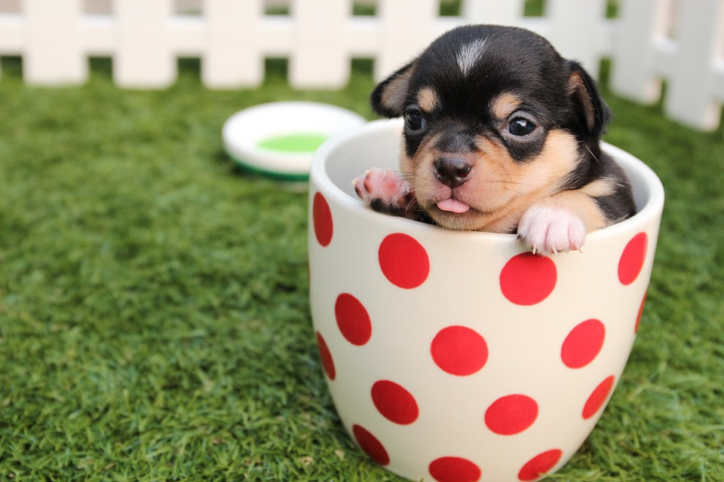
Day 3
Punctuation, Grammar and Vocabulary Focus – Mixed Skills
Think & Write
Look at this picture. What words and sentences does it make you think of? We are going to write a short piece of text based on the picture, using the following pattern of sentences:
Sentence 1
Write a sentence with an expanded noun phrase.
Sentence 2
Write a past progressive sentence about the puppy.
Sentence 3
Write a command sentence starting with a bossy (imperative) verb, telling the puppy what to do.
Sentence 4
Write a sentence containing the conjunction ‘but’.
Share your writing with a partner, your group or your whole class.

Slide 12
Day 3
Punctuation, Grammar and Vocabulary Focus – Mixed Skills
Think & Write - Answers
Here is an example of what you could have thought and written:
The tiny, cute puppy was sitting in a small, spotty cup.
The adorable puppy was sitting inside the mug to keep warm.
expanded noun phrase
past progressive sentence
Get out of the cup.
command sentence
The puppy tried to get out of the cup but it was stuck.
containing the conjunction ‘but
Share your writing with a partner, your group or your whole class.

Slide 13
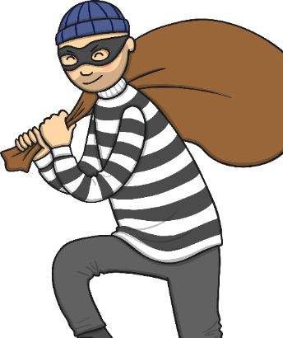
The Capital Letter Criminal
Day 4
Grammar Focus – G5.1: Capital letters.
The Capital Letter Criminal has broken in and stolen all of the capital letters from the story below. Can you put them all back in?
yesterday, the capital letter criminal broke into billington infant school and stole all of the capital letters! firstly, he took all of the capital letters from the register so that all of the children’s names are now written in lower-case! the sneaky thief then found the head teacher’s office and stole the capital letters from mrs. hazim’s door but he didn’t finish there! next, he went into the corridor and pinched all of the capital letters from class 2’s fantastic london display. he left the pupils’ pictures of the queen, big ben and buckingham palace all without the capital letters they need. what a devious devil he is!
Challenge: Write an apology from the Capital Letter Criminal using the conjunction ‘because’.

Slide 14
The Capital Letter Criminal - Answers
Day 4
Grammar Focus – G5.1: Capital letters.
Did you manage to put all of the capital letters back into the story? Let’s find out.
Yesterday, the capital letter criminal broke into Billington Infant School and stole all of the capital letters! Firstly, he took all of the capital letters from the register so that all of the children’s names are now written in lower-case! The sneaky thief then found the head teacher’s office and stole the capital letters from Mrs Hazim’s door but he didn’t finish there! Next, he went into the corridor and pinched all of the capital letters from class 2’s fantastic London display. He left the pupils’ pictures of The Queen, Big Ben and Buckingham Palace all without the capital letters they need. What a devious devil he is!
Challenge: I am sorry for breaking into school and stealing all of the capital letters because it was an unkind thing to do.
I will not do it again because I have learnt my lesson.

Slide 15
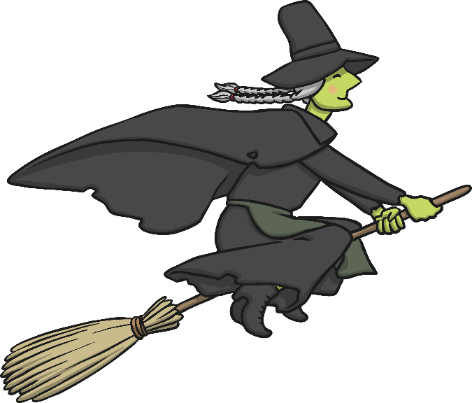
The Witch’s Watch
Day 5
Spelling Focus – S3: -tch endings.
Challenge: Pick three of the –tch words and make the silliest sentence you can.
Can you solve the riddles to find out which words, all ending in –tch, are missing from the witch’s watch?
I have an ____ that I need to scratch.
The football _____ is too wet to play on.
Don’t forget to ______ off the light.
I played a football _____.
Can you _____ a ball?
The car slid off the road into a _____.
The wicked _____ cast a spell.
_____ me as I ride my bike.

Slide 16
The Witch’s Watch
Day 5
Spelling Focus – S3: -tch endings.
Did you solve the riddles to find the missing words?
The football pitch is too wet to play on.
I have an itch that I need to scratch.
Don’t forget to switch off the light.
I played a football match.
The car slid off the road into a ditch.
Can you catch a ball?
The wicked witch cast a spell.
Watch me as I ride my bike.
The wicked witch got stuck in a ditch on the football pitch.

