Slide 1
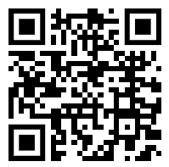
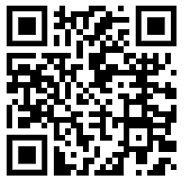
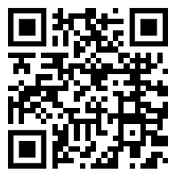
Year 1- Summer 1 Newsletter
Science
Our science unit for this half term is. ‘All about Animals.’ During these lessons we will learn to identify and name a variety of common animals including fish, amphibians, reptiles, birds and mammals. We will also learn how to identify and name a variety of common animals that are carnivores, herbivores and omnivores.
English
In English this term we will be using two wonderful texts; First Day at Bug School by Sam Lloyd and We are Here by Oliver Jeffers. This term we will be writing some of our own poetry and creating a non-chronological report. As always, we will be focusing on important grammar such as capital letters, in the correct places, using question marks when needed and full stops..
. As we are getting closer to the Phonics Screening Check the children may come home with additional homework to support their knowledge and understanding.
Art This project will teach the children about artwork depicting streets and buildings and focuses on the work of the American pop artist, James Rizzi. The children will create a 3-D mural based on Rizzi's work.
Mathematics
During this 6 week term we will cover the following units of work:
Multiplication and Division
Fractions
To support your child at home it would beneficial to practise counting in jumps of 2, 5 and 10. It would also be good to start discussing sharing into equal groups of 2 and 4.
Please use the QR codes below to see helpful videos;
Religious Education
In RE the children will be learning about different religious festivals. We will also cover how different religions welcome and celebrate the birth of a new baby.
DIARY DATES
First day back: Monday 15th April
RSPB Trip: Thursday 16th May
Last day of term: Friday 24th May
School Closed - Thursday 2nd May 2024 Polling Day -Monday 6th May 2024 Bank Holiday
Geography During this topic the children will learn about; physical and human features, maps, compass points, and positional and directional language. They will also learn about the equator, hemispheres and continents. The children carry out simple fieldwork to find out about local physical and human features.

Slide 2
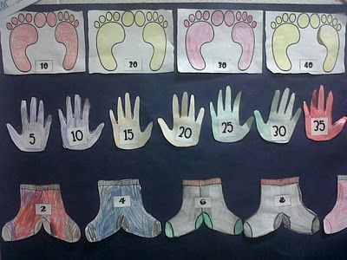
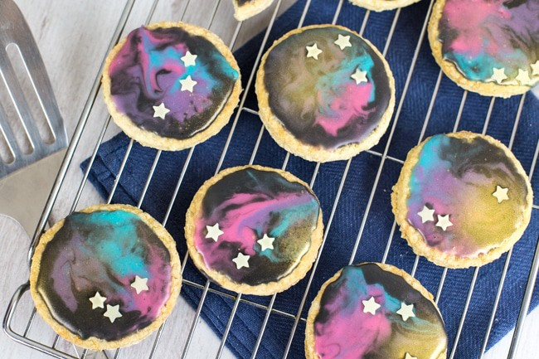
In Year 1 our topic is Our Wonderful World. Here are some examples of possible homework that you may wish to complete with your child. Please feel free to complete another task that is not stated on this list. If you would like any clarification about our approach to homework please feel free to ask. Please bring any evidence of your homework into class before Friday 17th May 2024..
Year 1 Homework Map- Summer 1
Create a poster to show your 2s, 5, and 10 times tables.
.Go on a minibeast hunt! Describe what you find. Can you make your own poem about the minibeasts that you find?
Learn about some animals that fit into these categories: fish, amphibians, reptiles, birds and mammals.
Create your own wonderful world! What would it be made of? What kinds of things could you find there?
You can draw this or make a sculpture ☺
Create a poster about the different continents.
Can you write your own story about travelling to a different world?
Weekly Homework
Spellings
Reading
We would also like to encourage you to access NUMBOTS regularly to help develop children’s mathematical understanding. Weekly rewards will be given out based on progress, minutes played and the amount of correct answers. You will find login details in reading records.
Make some cookies that look ‘out of this world!’
Use different coloured icing to decorate them. Take some photos while you are making them and write some instructions to go with your pictures.

